Slide 1

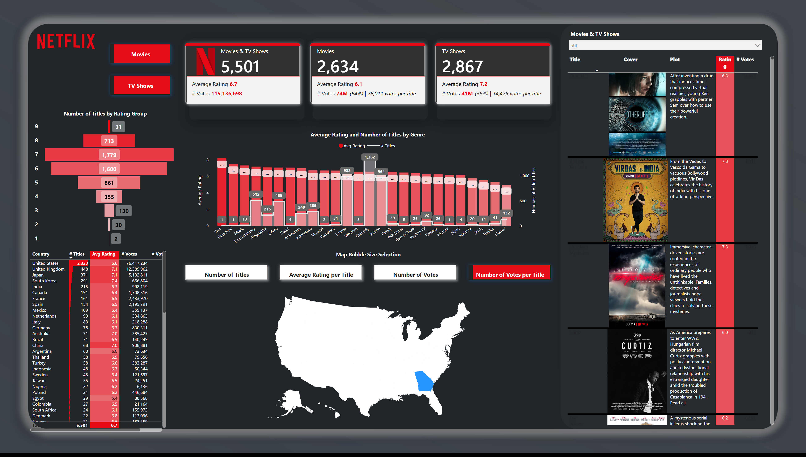


PBI - Netflix Project
View in Power BI
Last data refresh:
5/14/2024 5:47:43 PM UTC
Downloaded at:
5/14/2024 5:49:51 PM UTC

Slide 2
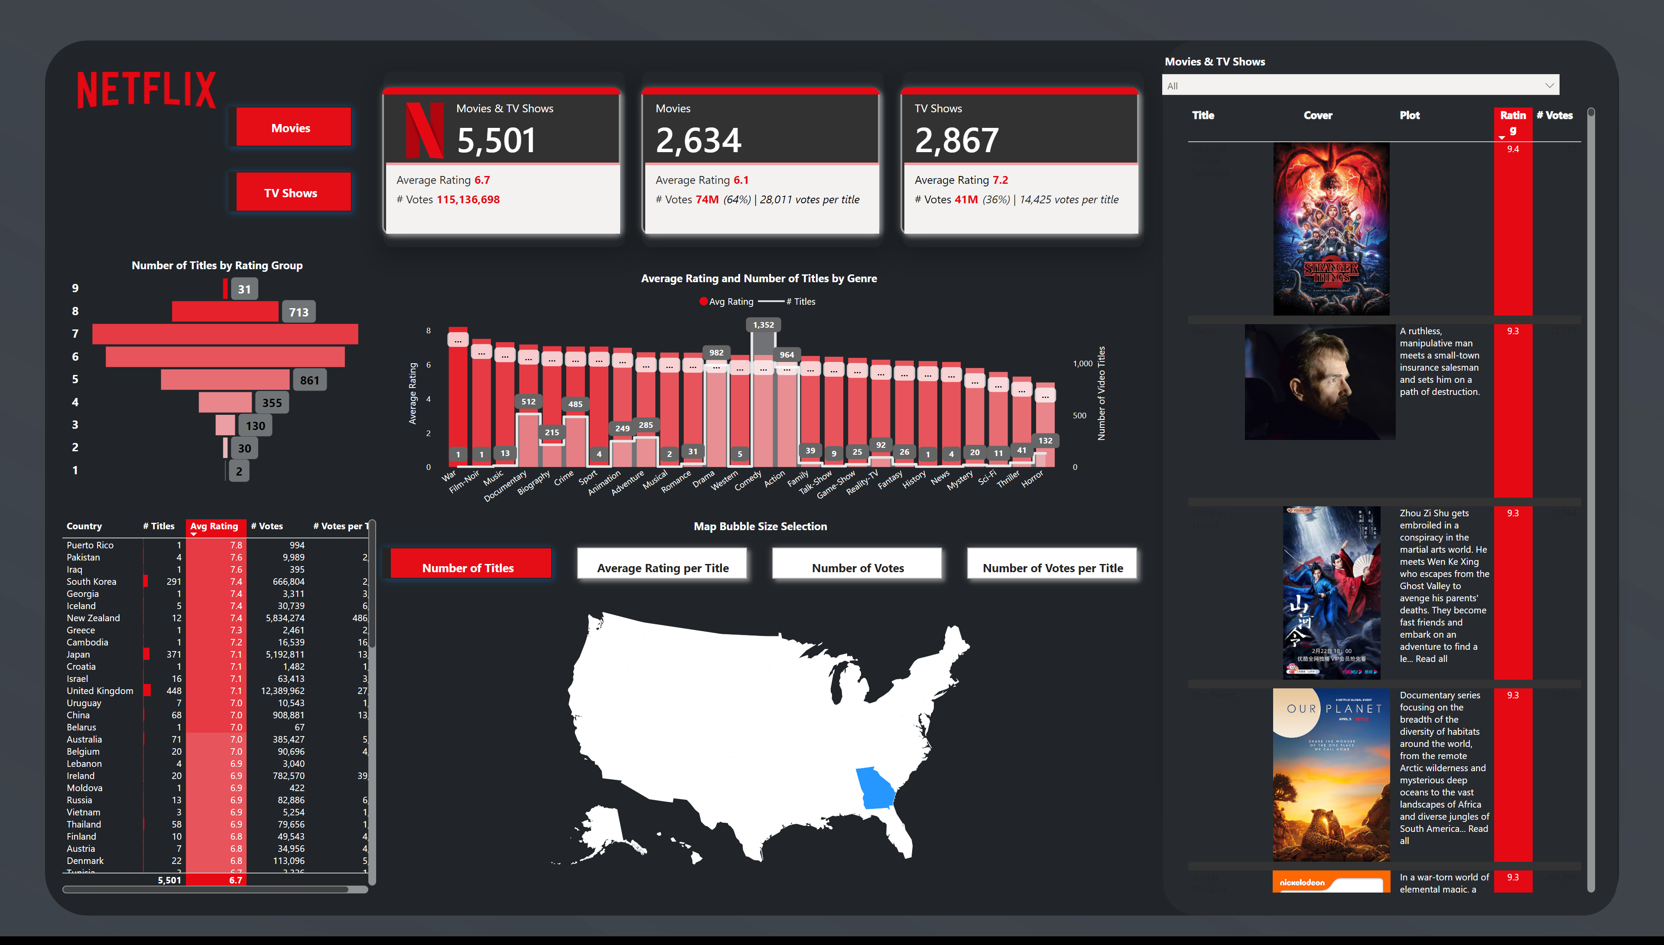
Rating Analytics 2
Notes:
shapeMap
No alt text provided
tableEx
No alt text provided
Content Catalog
No alt text provided
Number of Titles by Rating Group
No alt text provided
Average Rating and Number of Titles by Genre
No alt text provided
cardVisual
No alt text provided
advancedSlicerVisual
No alt text provided
Movies and TV Shows
No alt text provided
Map Bubble Size Selection
No alt text provided
image
No alt text provided

Slide 3
Rating Analytics3
Notes:
shapeMap
No alt text provided
tableEx
No alt text provided
Content Catalog
No alt text provided
Number of Titles by Rating Group
No alt text provided
Average Rating and Number of Titles by Genre
No alt text provided
cardVisual
No alt text provided
advancedSlicerVisual
No alt text provided
Movies and TV Shows
No alt text provided
Map Bubble Size Selection
No alt text provided
image
No alt text provided

